Slide 1


STREAMLIST+
SUBSCRIPTION
STREAMING PLATFORM
Prepared by Itiel I. King
INT499: Information Technology Capstone Project
Gantt Chart and Wireframe Development
Week 2: Assignment 2, Part 1
Software Requirements Specification (SRS)
StreamList+ Subscription Streaming Platform

Slide 2
PROJECT GANTT CHART
StreamList+ Software Development Timeline
Task
W1
W2
W3
W4
W5
W6
W7
W8
W9
W10
W11
W12
Requirements Analysis
Wireframe Design
User Authentication Module
Subscription Management Module
Content Search Module
Recommendation Engine Development
Watchlist Feature Development
Ratings and Reviews Feature
Streaming Playback Integration
User Dashboard Development
Testing and Quality Assurance
Final Deployment
Development Tasks
Testing Phase
Deployment Phase
Figure 1. StreamList+ Software Development Timeline and Task Dependencies

Slide 3
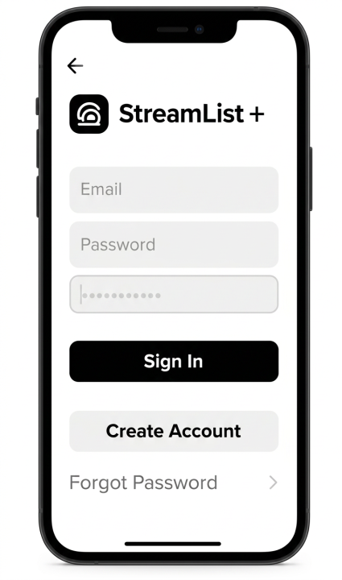
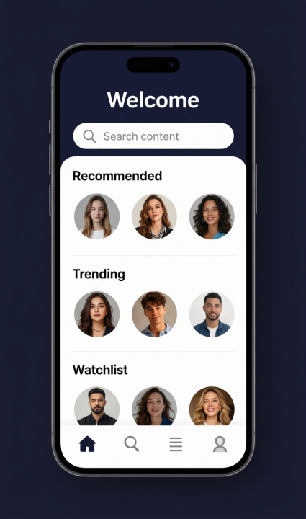
WIREFRAME OVERVIEW
The StreamList+ wireframes illustrate the application's core user interfaces, including authentication, content discovery, recommendations, and navigation features.
Figure 1. Login and Registration Screen
Figure 2. User Dashboard Screen
Email Field
Search Bar
Password Field
Recommendations
Sign In
Watchlist Preview
Create Account
Subscription Status
Figures 1–2. StreamList+ Core User Interface Wireframes

Slide 4
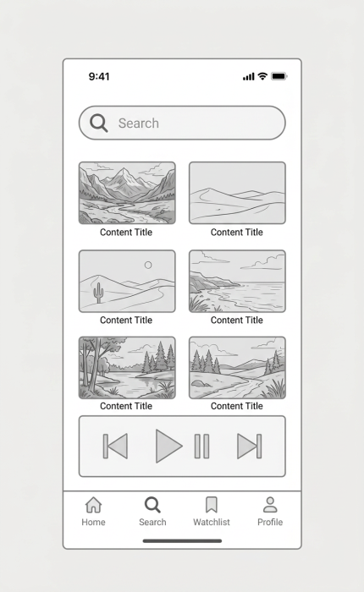
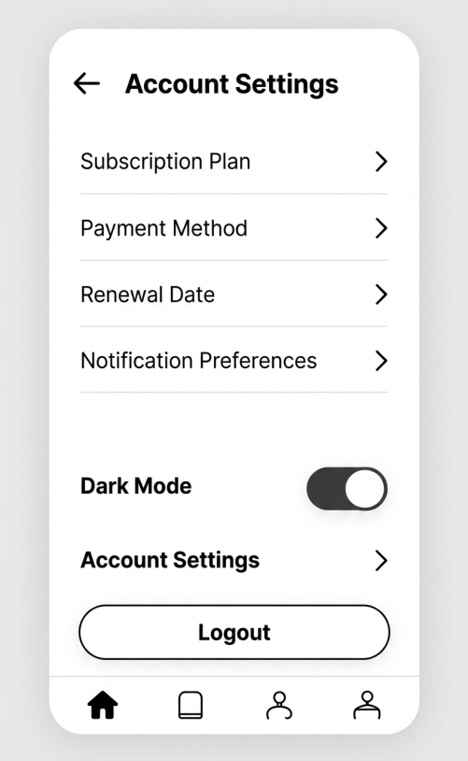
ADDITIONAL WIREFRAMES
The Search & Streaming and Account Management wireframes demonstrate content discovery, watchlist management, subscription settings, and user account controls within StreamList+.
Figure 3. Search and Streaming Screen
Figure 4. Account & Subscription Management
Search Bar
Subscription Settings
Payment Method
Content Results
Renewal Information
Streaming Controls
Notification Preferences
Watchlist Access
Dark Mode Toggle
Figures 3–4. StreamList+ Advanced User Interface Wireframes

Slide 5
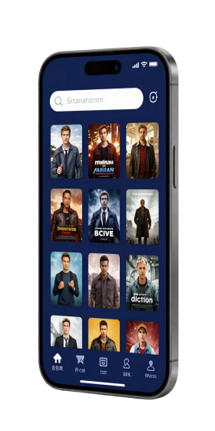
NAVIGATION FLOW AND PROJECT SUMMARY
StreamList+ is a centralized streaming platform that enables users to search content, manage subscriptions, receive personalized recommendations, create watchlists, and stream media through a single application.
Key Features
Navigation Flow
Login & Registration
Unified Content Search
Personalized Recommendations
User Dashboard
Watchlist Management
Subscription Management
Search & Streaming
Streaming Playback
Cross-Device Accessibility
Watchlist
Account & Subscription Management
Figure 4. StreamList+ Navigation Flow and Feature Summary

